Slide 1
Graph Theory Shortest Paths II Bellman-Ford algorithm
Design and Analysis of Algorithms

Slide 2






Negative-weight cycles
Recall: If a graph G = (V, E) contains a negative- weight cycle, then some shortest paths may not exist.
Example:
…
< 0
u v
Bellman-Ford algorithm: Finds all shortest-path lengths from a source s ∈ V to all v ∈ V or determines that a negative-weight cycle exists.
Copyright © 2001-5 by Erik D. Demaine and Charles E. Leiserson
L18.3

Slide 3
Bellman-Ford algorithm
d[s] ← 0
for each v ∈ V – {s}
do d[v] ← ∞
initialization
for i ← 1 to |V| – 1
do for each edge (u, v) ∈ E
do if d[v] > d[u] + w(u, v)
then d[v] ← d[u] + w(u, v)
for each edge (u, v) ∈ E
relaxation step
do if d[v] > d[u] + w(u, v)
then report that a negative-weight cycle exists
At the end, d[v] = δ(s, v), if no negative-weight cycles. Time = O(VE).
Copyright © 2001-5 by Erik D. Demaine and Charles E. Leiserson
L18.4

Slide 4










Example of Bellman-Ford
B
2
–1
A
3
2
E
1
4
–3
C
D
5
Copyright © 2001-5 by Erik D. Demaine and Charles E. Leiserson
L18.5

Slide 5
Example of Bellman-Ford
B
2
–1
A
3
2
E
1
4
–3
C
D
5
Copyright © 2001-5 by Erik D. Demaine and Charles E. Leiserson
L18.5

Slide 6
Example of Bellman-Ford
∞
B
–1
2
0
∞
A
3
2
E
1
4
–3
C
∞
D
∞
5
Initialization.
Copyright © 2001-5 by Erik D. Demaine and Charles E. Leiserson
L18.6

Slide 7
Example of Bellman-Ford
∞
B
1
2
–1
0
∞
7
3
4
3
2
A
1
E
5
4
8
–3
2
C
∞
6
D
∞
5
Note: Red number with edges is showing order of edge relation
Copyright © 2001-5 by Erik D. Demaine and Charles E. Leiserson
L18.7

Slide 8
Example of Bellman-Ford
∞
B
1
2
–1
0
∞
7
3
4
3
2
A
1
E
5
4
8
–3
2
C
∞
6
D
∞
5
Copyright © 2001-5 by Erik D. Demaine and Charles E. Leiserson
L18.7

Slide 9
Example of Bellman-Ford
∞
B
1
2
–1
0
∞
7
3
4
3
2
A
1
E
5
4
8
–3
2
C
∞
6
D
∞
5
Copyright © 2001-5 by Erik D. Demaine and Charles E. Leiserson
L18.7

Slide 10
Example of Bellman-Ford
∞
B
1
2
–1
0
∞
7
3
4
3
2
A
1
E
5
4
8
–3
2
C
∞
6
D
∞
5
Copyright © 2001-5 by Erik D. Demaine and Charles E. Leiserson
L18.7

Slide 11
Example of Bellman-Ford
−1
B
1
2
–1
0
∞
7
3
4
3
2
A
1
E
5
4
8
–3
2
C
∞
6
D
∞
5
Copyright © 2001-5 by Erik D. Demaine and Charles E. Leiserson
L18.7

Slide 12
Example of Bellman-Ford
−1
B
1
2
–1
0
∞
7
3
4
3
2
A
1
E
5
4
8
–3
2
C
4
6
D
∞
5
Copyright © 2001-5 by Erik D. Demaine and Charles E. Leiserson
L18.7

Slide 13
Example of Bellman-Ford
−1
B
1
2
–1
0
∞
7
3
4
3
2
A
1
E
5
4
8
–3
2
C
4
6
D
∞
5
Copyright © 2001-5 by Erik D. Demaine and Charles E. Leiserson
L18.7

Slide 14
Example of Bellman-Ford
−1
B
1
2
–1
0
∞
7
3
4
3
2
A
1
E
5
4
8
–3
2
C
2
6
D
∞
5
Copyright © 2001-5 by Erik D. Demaine and Charles E. Leiserson
L18.7

Slide 15
Example of Bellman-Ford
−1
B
1
2
–1
0
∞
7
3
4
3
2
A
1
E
5
4
8
–3
2
C
2
6
D
∞
5
Copyright © 2001-5 by Erik D. Demaine and Charles E. Leiserson
L18.7

Slide 16
Example of Bellman-Ford
−1
B
1
2
–1
0
∞
7
3
4
3
2
A
1
E
5
4
8
–3
2
C
2
6
D
∞
5
End of Pass 1
Copyright © 2001-5 by Erik D. Demaine and Charles E. Leiserson
L18.7

Slide 17
Example of Bellman-Ford
−1
B
1
2
–1
0
∞
7
3
4
3
2
A
1
E
5
4
8
–3
2
C
2
6
D
∞
5
End of Pass 1
.
Copyright © 2001-5 by Erik D. Demaine and Charles E. Leiserson
L18.7

Slide 18
Example of Bellman-Ford-Pass2
−1
B
1
2
–1
0
1
7
3
4
3
2
A
1
E
5
4
8
–3
2
C
2
6
D
∞
5
Note: Red number with edges is showing order of edge relation
Copyright © 2001-5 by Erik D. Demaine and Charles E. Leiserson
L18.7

Slide 19
Example of Bellman-Ford
−1
B
1
2
–1
0
1
7
3
4
3
2
A
1
E
5
4
8
–3
2
C
2
6
D
∞
5
Copyright © 2001-5 by Erik D. Demaine and Charles E. Leiserson
L18.7

Slide 20
Example of Bellman-Ford
−1
B
1
2
–1
0
1
7
3
4
3
2
A
1
E
5
4
8
–3
2
C
2
6
D
1
5
Copyright © 2001-5 by Erik D. Demaine and Charles E. Leiserson
L18.7

Slide 21
Example of Bellman-Ford
−1
B
1
2
–1
0
1
7
3
4
3
2
A
1
E
5
4
8
–3
2
C
2
6
D
1
5
Copyright © 2001-5 by Erik D. Demaine and Charles E. Leiserson
L18.7

Slide 22
Example of Bellman-Ford
−1
B
1
2
–1
0
1
7
3
4
3
2
A
1
E
5
4
8
–3
2
C
2
6
D
1
5
Copyright © 2001-5 by Erik D. Demaine and Charles E. Leiserson
L18.7

Slide 23
Example of Bellman-Ford
−1
B
1
2
–1
0
1
7
3
4
3
2
A
1
E
5
4
8
–3
2
C
2
6
D
1
5
Copyright © 2001-5 by Erik D. Demaine and Charles E. Leiserson
L18.7

Slide 24
Example of Bellman-Ford
−1
B
1
2
–1
0
1
7
3
4
3
2
A
1
E
5
4
8
–3
2
C
2
6
D
1
5
Copyright © 2001-5 by Erik D. Demaine and Charles E. Leiserson
L18.7

Slide 25
Example of Bellman-Ford
−1
B
1
2
–1
0
1
7
3
4
3
2
A
1
E
5
4
8
–3
2
C
2
6
D
−2
5
Copyright © 2001-5 by Erik D. Demaine and Charles E. Leiserson
L18.7

Slide 26
Example of Bellman-Ford
−1
B
1
2
–1
0
1
7
3
4
3
2
A
1
E
5
4
8
–3
2
C
2
6
D
−2
5
Copyright © 2001-5 by Erik D. Demaine and Charles E. Leiserson
L18.7

Slide 27
Example of Bellman-Ford
−1
B
1
2
–1
0
1
7
3
4
3
2
A
1
E
5
4
8
–3
2
C
2
6
D
−2
5
End of pass 2 (and 3 and 4).
Copyright © 2001-5 by Erik D. Demaine and Charles E. Leiserson
L18.7

Slide 28
Correctness
Theorem. If G = (V, E) contains no negative- weight cycles, then after the Bellman-Ford algorithm executes, d[v] = δ(s, v) for all v ∈ V.
Copyright © 2001-5 by Erik D. Demaine and Charles E. Leiserson
L18.26

Slide 29


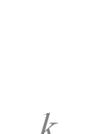






Correctness
Theorem. If G = (V, E) contains no negative- weight cycles, then after the Bellman-Ford algorithm executes, d[v] = δ(s, v) for all v ∈ V. Proof. Let v ∈ V be any vertex, and consider a shortest path p from s to v with the minimum number of edges.
v
s v₀
v
1
v
3
v
k
v
2
p:
…
Since p is a shortest path, we have
δ(s, v_{i}) = δ(s, v_{i–1}) + w(v_{i–1}, v_{i}) .
Copyright © 2001-5 by Erik D. Demaine and Charles E. Leiserson
L18.27

Slide 30


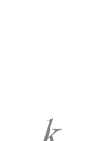




Correctness (continued)
v v
k
s v₀
v
1
v
3
v
2
p:
…
Initially, d[v₀] = 0 = δ(s, v₀), and d[v₀] is unchanged by subsequent relaxations (because of the lemma from Shortest Paths I that d[v] ≥ δ(s, v)).
After 1 pass through E, we have d[v₁] = δ(s, v₁).
After 2 passes through E, we have d[v₂] = δ(s, v₂).
After k passes through E, we have d[v_{k}] = δ(s, v_{k}).

Since G contains no negative-weight cycles, p is simple. Longest simple path has ≤ |V| – 1 edges.
Copyright © 2001-5 by Erik D. Demaine and Charles E. Leiserson
L18.28

Slide 31
Detection of negative-weight cycles
Corollary. If a value d[v] fails to converge after
|V| – 1 passes, there exists a negative-weight cycle in G reachable from s.
Copyright © 2001-5 by Erik D. Demaine and Charles E. Leiserson
L18.29

Slide 32
Shortest paths
Single-source shortest paths
Nonnegative edge weights
Dijkstra’s algorithm: O(E + V lg V)
General
Bellman-Ford algorithm: O(VE)
DAG
One pass of Bellman-Ford: O(V + E)
Copyright © 2001-5 by Erik D. Demaine and Charles E. Leiserson
L18.2

Slide 33
Shortest paths
Single-source shortest paths
Nonnegative edge weights
Dijkstra’s algorithm: O(E + V lg V)
General
Bellman-Ford algorithm: O(VE)
DAG
One pass of Bellman-Ford: O(V + E)
All-pairs shortest paths
Nonnegative edge weights
Dijkstra’s algorithm |V| times: O(VE + V ² lg V)
Copyright © 2001-5 by Erik D. Demaine and Charles E. Leiserson
L18.3

Slide 34
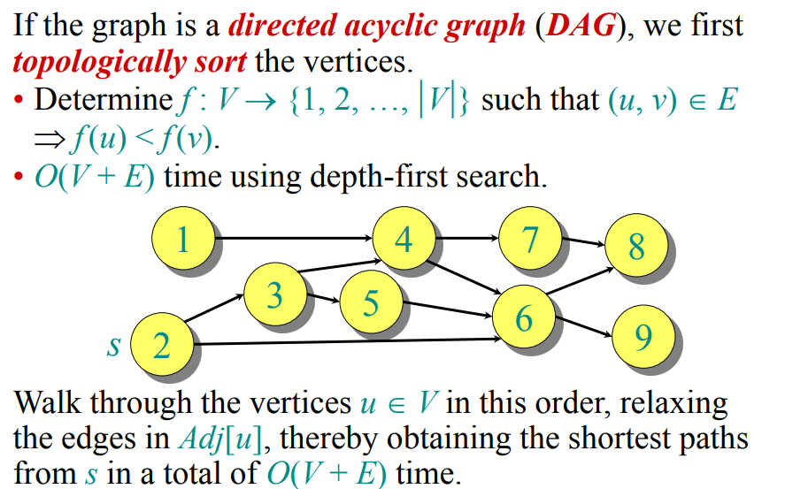
Directed Acyclic Graph (DAG)

Slide 35
All-pairs shortest paths
Input: Digraph G = (V, E), where V = {1, 2,
…, n}, with edge-weight function w : E → R.
Output: n × n matrix of shortest-path lengths
δ(i, j) for all i, j ∈ V.
Copyright © 2001-5 by Erik D. Demaine and Charles E. Leiserson
L18.4

Slide 36
All-pairs shortest paths
Input: Digraph G = (V, E), where V = {1, 2,
…, n}, with edge-weight function w : E → R.
Output: n × n matrix of shortest-path lengths
δ(i, j) for all i, j ∈ V.
IDEA:
Run Bellman-Ford once from each vertex.
Time = O(V ²E).
Dense graph (Θ(n²) edges) ⇒ Θ(n ⁴) time in the worst case.
Good first try!
Copyright © 2001-5 by Erik D. Demaine and Charles E. Leiserson
L18.5

Slide 37
Reference
Introduction to Algorithms
Single Source Shortest Path
Chapter # 24
Thomas H. Cormen

